Slide 1
Azure AD Conditional Access Demystified
Kenneth van Surksum

Slide 2

Our topics for Today!
Why do we need conditional access?
What is conditional access?
How does conditional access work?
Implementing Conditional Access
Tips & tricks from the field

Slide 3



Slide 4
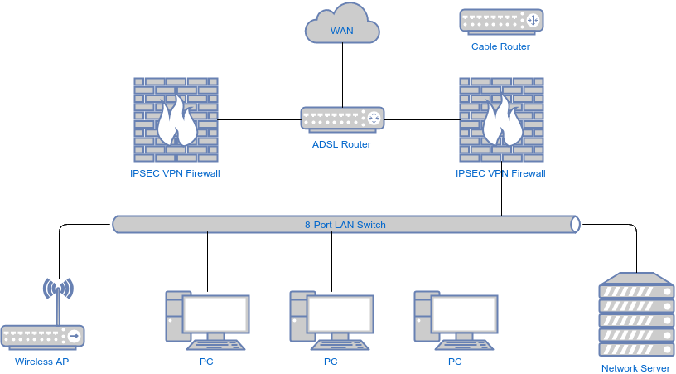
Yesterday's Infrastructure ;)

Slide 5
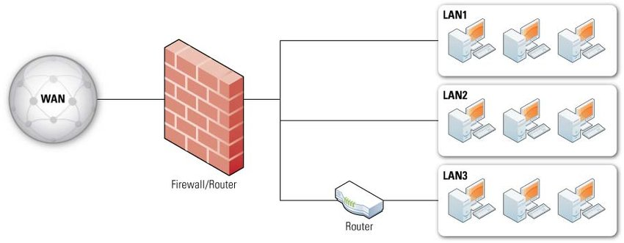
Yesterday's Infrastructure ;)

Slide 6
Traditional IT environment
1 Personal Computer
Multiple Personal Computers
Network
Authentication
Files are stored centrally on fileshares
Printing using print servers
Client/Server applications
Email/Internet
LAN extension (VPN)
Security by using Firewalls
Management via LAN
Internal collaboration, sending documents to each other via email/working of fileshares

Slide 7
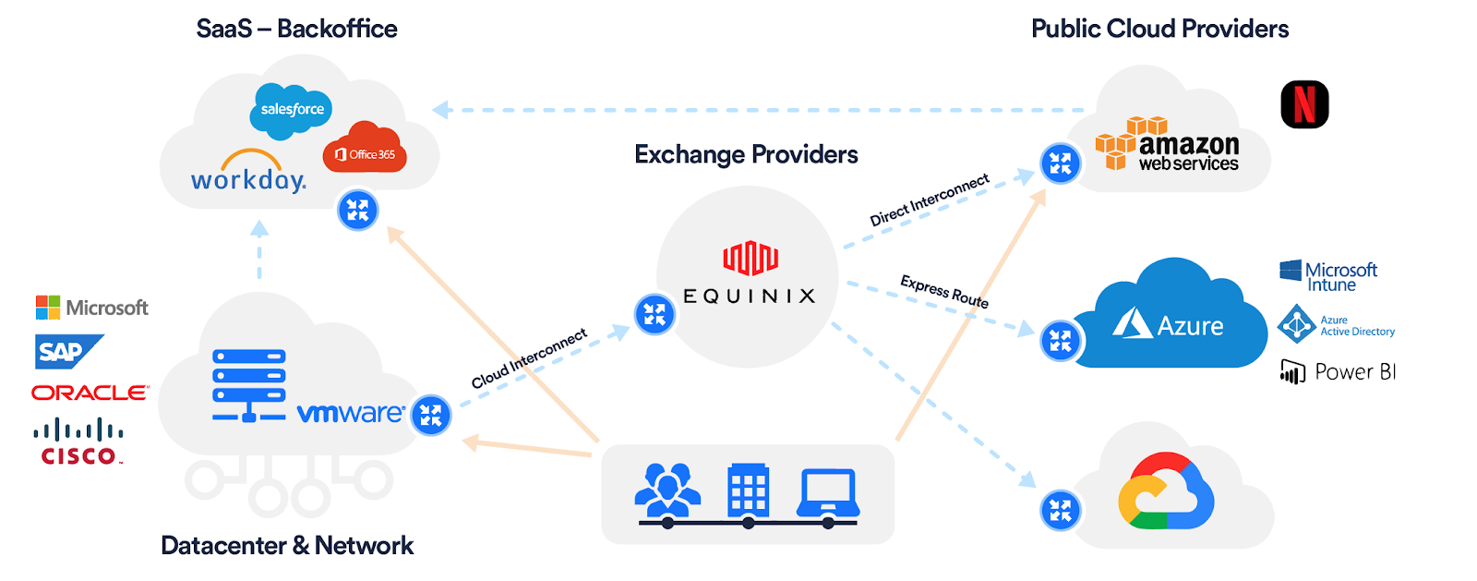
Tomorrow's Infrastructure

Slide 8
Tomorrows Workplace
Work anywhere at any time
Divers set of Workplaces (Laptops, Desktops, Mobile)
High usage of SaaS offerings (Office 365, Salesforce, Dynamics)
Company data stored in the cloud
Less need to print
Safety provided by the identity
Managed from the Internet
Internal & external collaboration in a central location

Slide 9
Today’s Infrastructure = Hybrid

Slide 10
Today’s Infrastructure = Hybrid

Slide 11


Identity is the new perimeter

Slide 12






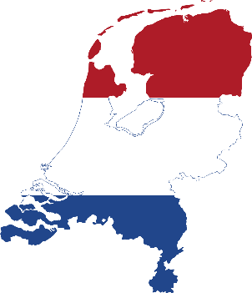
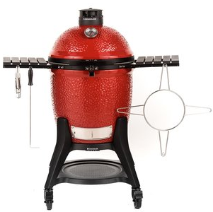
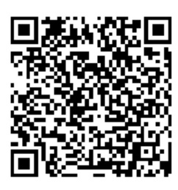
About “Kenneth van Surksum”
Focus
Certifications
Modern Workplace Consultant, Microsoft Certified Trainer, Co-founder and organizer at Workplace Ninja User Group Netherlands
Microsoft 365 Certified Enterprise Administrator
Microsoft Certified Azure Solutions Architect
From
Hobbies
Picture
The Netherlands
Cooking on my Kamado Joe & Sports
My Blog
Contact
https://www.vansurksum.com
kenneth@vansurksum.com
https://twitter.com/kennethvs
https://www.linkedin.com/in/kennethvansurksum

Slide 13

Never Trust. Always verify.
Increase Assurance
Remediate Risk
Allow full access
Allow limited Access
Block access
Signal
Decision
Enforcement
to make an informed decision
Device Risk
Device Management
Threat Detection
and more…
User Risk
Multi-factor Authentication
Behavior Analytics
and more…
based on organization’s policy
Apply to inbound requests
Re-evaluate during session
of policy across resources
Modern Applications
SaaS Applications
Legacy Applications
And more…
Notes:
Key Takeaway – These are the key basic components of a Zero Trust Strategy
See video at this site for more information/context - https://docs.microsoft.com/en-us/microsoft-365/security/office-365-security/ciso-workshop-module-3#part-2-zero-trust-definition-and-models-1537

Slide 14
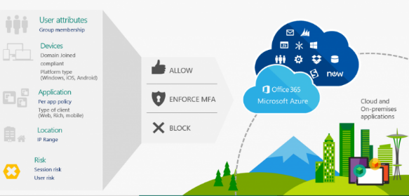
What is Conditional Access?
“With Conditional Access, you can implement automated access control decisions for accessing your cloud apps that are based on conditions.” and “Conditional Access policies are enforced after the first-factor authentication has been completed. Therefore, Conditional Access is not intended as a first line defense for scenarios like denial-of-service (DoS) attacks, but can utilize signals from these events (e.g. the sign-in risk level, location of the request, and so on) to determine access.”
Notes:
The way I see it, the best way to explain what Conditional Access does, is by making the comparison to a firewall. A firewall determines what traffic can access your resources, under what circumstances and Conditional Access sort of does the same. Conditional Access describes under what circumstances users can access your cloud applications.
With cloud applications Microsoft means applications which use Azure Active Directory (Azure AD) for authentication. Azure Active Directory (Azure AD) is Microsoft’s cloud-based identity and access management service. So if you access an SaaS based application through Azure AD you can use Conditional Access as your “access firewall”. Microsoft’s SaaS offerings like Office 365, Dynamics, the Azure Portal all use Azure AD as its authorization mechanism.
This also means that if you can access the SaaS application in some other way, you can bypass Conditional Access making the solution less effective. For example, you only the credentials of the application in Azure AD, and through Azure AD you can login using SSO making use of Conditional Access, but when accessing the SaaS application directly you can also provide your userid and password. So it’s important that you modify the SaaS identity provider to leverage Azure Active Directory.

Slide 15
What is Conditional Access?
Put conditions in place to access to company data and apps. (Identity and device)
Can be compared with a Network Firewall but then for your identity
Resources being accessed must use Azure AD as authentication provider
Even though you can use it, doesn’t mean you are licensed
When using ADFS, it can become quite complex – ask yourself whether you still need ADFS
Adds points to your Secure Score
Notes:
Some of the Conditional Access settings require that you have licensed other products, for example in order to use the sign-in risk condition you need to have Azure AD Identity Protection licensed. (Part of Azure AD premium P2). In order integrate Conditional Access with Microsoft Cloud App Security (MCAS), you must of course have MCAS licensed as well.

Slide 16
Prerequisites
We must first block legacy authentication for Conditional Access to work in all scenarios.
Azure AD Premium P1 or P2 license (if not you can use Security defaults)
Microsoft Endpoint Manager (if you want to leverage compliance)
Rethink your reauthentication settings (MFA global settings/KMSI)
Make sure that you define 2 break glass accounts - https://docs.microsoft.com/en-us/azure/active-directory/roles/security-emergency-access

Slide 17
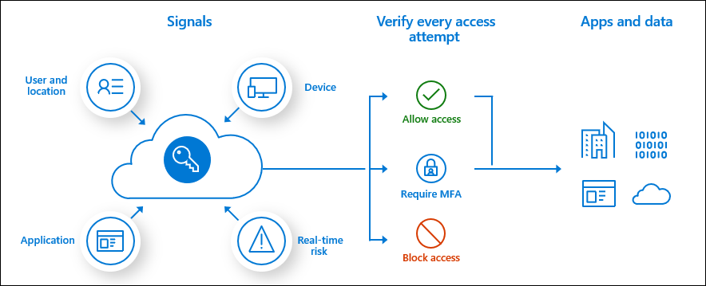

Slide 18











Azure AD conditional access (Zero Trust)
Azure AD
ADFS
Conditions
Controls
MSA
40TB
Google ID
Employee & Partner Users and Roles
Allow/block
access
Microsoft Cloud
Android
Session Risk
iOS
Trusted & Compliant Devices
Machine learning
3
MacOS
Limited
access
Microsoft Cloud App Security
Windows
Windows Defender ATP
Require
MFA
Real time Evaluation
Engine
Cloud SaaS apps
Force
password
reset
Geo-location
Physical & Virtual Location
******
Corporate Network
Policies
Effective policy
Client apps & Auth Method
Block legacy authentication
Browser apps
Client apps
On-premises & web apps
Notes:
Expanded view of all the conditions that are taken into account for access and the controls that you have based on the risk.
Our 40 TB of data from all the conditions, integrated EMS/M365 apps, and our security intelligence network are analyzed in real-time to determine the right policy.
Example: If an ADFS user signs in on a Windows machine with Windows Defender ATP we can take into account the health of the account and the device, as well as their location and if they are on the corporate network and what type of app they are trying to access. If they are on the corporate network in their normal office then the data produces a low risk score. The effective policy is to all access to the app. If, however, the person was logging in from a location across the world (in a short amount of time – impossible travel) and/or the Windows Defender ATP finds that the machine has been infected, the access can be blocked. If the user login and device are healthy, but it was a location they haven’t signed in from before (on a trip or other computer) then the user could be prompted with MFA or have limited access to certain applications.

Slide 19

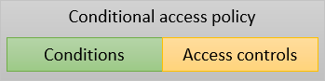
How does it work?
Notes:
Assignments = Conditions

Slide 20
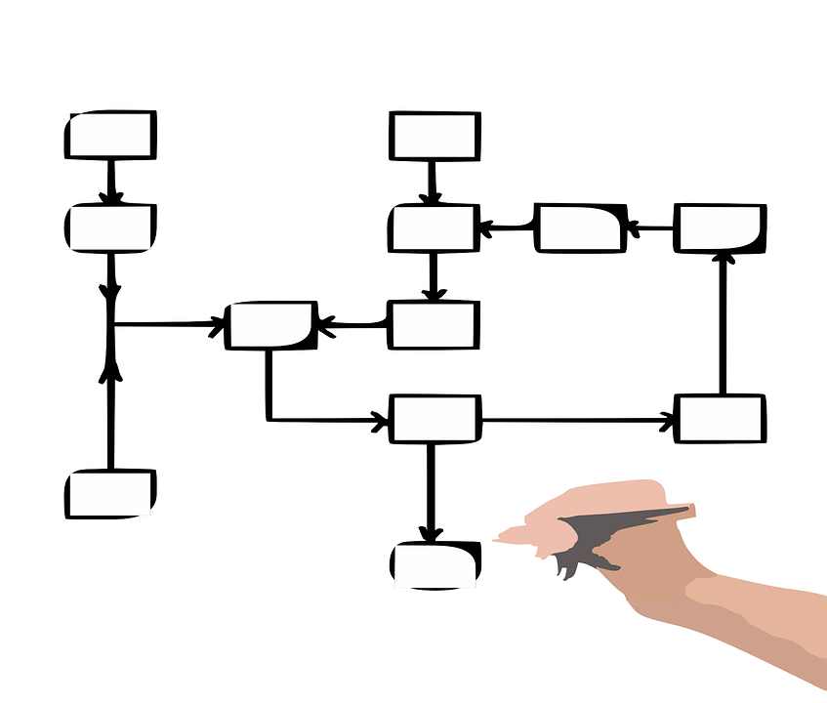
How does it really work?
Access to <provided> Clouds Apps except <provided> Cloud apps by <provided> users and/or <provided> roles and/or <provided> groups except <provided> users and/or <provided> groups using <provided> User Risk and/or <provided> Sign-in Risk and/or <provided> Device Platform except <provided> Device Platform from <provided> Location except <provided> Location using <provided> Client apps with <provided> device state, except <provided> device state Grants, Grants but <provided requirement must be fulfilled> or Blocks access and/or applies Session controls.

Slide 21
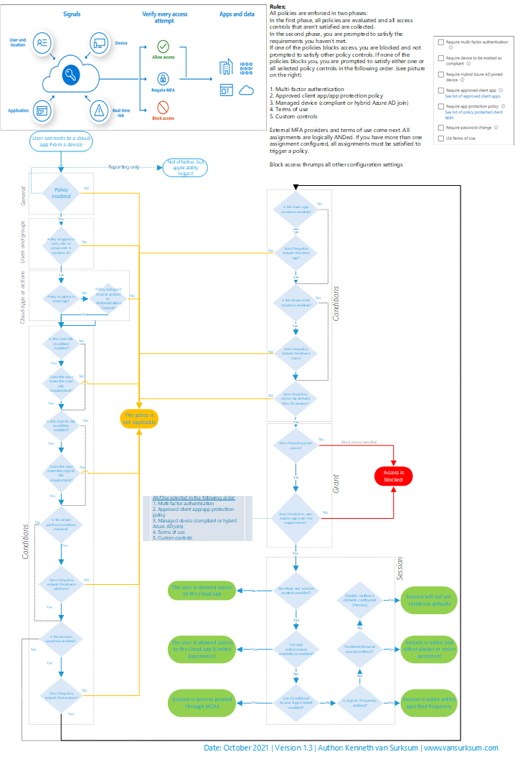

Conditional Access workflow – Cheat sheet
https://github.com/kennethvs/blog/blob/master/Conditional%20Access%20Workflow%20-%20v1.3.pdf

Slide 22
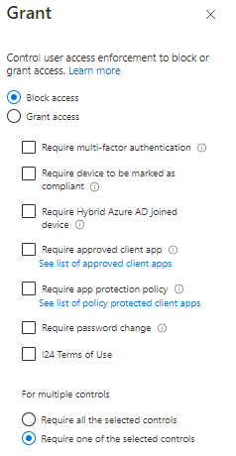
Important rules
All policies are enforced in two phases
In the first phase, all policies are evaluated (in parallel) and all access controls that aren’t satisfied are collected.
In the second phase, you are prompted to satisfy the requirements you haven’t met.
If one of the policies blocks access, you are blocked and not prompted to satisfy other policy controls. If none of the policies blocks you, you are prompted to satisfy other policy controls in the following order:
1. Multi-factor authentication
2. Approved client app/app protection policy
3. Managed device (compliant or hybrid Azure AD join)
4. Terms of use
5. Custom controls
Policies are not effective immediately
With Continuous Access Evaluation we will get quicker results

Slide 23
Conditional Access
Creating your conditional access policy

Slide 24

Designing a Conditional Access Strategy
What kind of devices does the customer use to access cloud apps?
What kind of applications are used to access cloud apps?
Is this a green field implementation, or are the cloud apps already in use without any conditional access policies in action?
Does the customer use Intune and which scenarios are built into Intune
Mobile Device Management
Mobile Application Management
Is every user treated equally when it comes to access to the cloud apps, or can we distinct personas with different requirements when it comes to Conditional Access
Which licensing is the customer using? My opinion is that you need E5 functionality for administrators or people who are local administrator at least nowadays.
How are licenses being assigned to users (groups, directly)
Are there any service accounts used that interact with the cloud apps?
What are the reauthentication settings for the customer?
Is Modern Authentication already enabled for Exchange Online and Skype for Business online?
Is the company storing password hashes in Azure Active Directory?
Are there cloud apps depending on each other?
Notes:
Based on my experience the main goal of implementing Conditional Access is that you want to prevent access to your company data in situations where you don’t have control over the data. That means that ideally cloud apps can only be accessed by:
Devices which are under company control and are compliant
Applications which are under company control and are compliant
Browser sessions on managed devices where data can be stored locally
Browser sessions on non-managed devices where data can only be opened in the browser session and no data is left behind on the device
All the other scenario’s possible are either to fullfill requirements in order to successfully use Conditional Access or are additional security measures like always enforcing MFA when Azure AD administrators log in. It might also be that you need some “temporary” conditional access policies while migrating to the designed situation.

Slide 25

Designing a Conditional Access Strategy
Azure Active Directory Conditional Access Deployment Plan:
https://aka.ms/CADPDownload
How To: Plan your Conditional Access deployment in Azure Active Directory – https://docs.microsoft.com/en-us/azure/active-directory/conditional-access/plan-conditional-access
Conditional Access documentation spreadsheet - https://gallery.technet.microsoft.com/Conditional-Access-dc903421

Slide 26
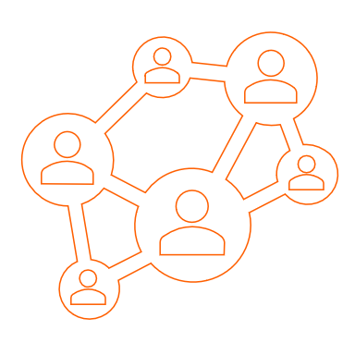
Define Scenarios
Scenario 1: Allow devices managed by Intune access all the cloud apps using Apps and Desktop Clients and Modern Authentication Clients if compliant
Access to “All Cloud Apps” by “Users with EMS License” using “Any” device platform” coming from “any location” using “Mobile Apps and Desktop Clients” or “Modern authentication clients” is allowed, but device must be compliant.
Scenario 2: Only allow Apps we can manage to access cloud apps when device is not managed.
Allow users with EMS License using devices not managed by intune to access (portion of, t.b.d.) cloud apps, using clients which we can manage using MAM policies (approved clients list)
Scenario 3: Allow browser access to all the cloud apps from a trusted location
When users access the cloud apps from a trusted location they can login without using any additional form of authentication
Scenario 4: Allow browser access to all the cloud apps from an untrusted location but use MFA and restrict the browser session (when possible)
When users access the cloud apps from a non trusted location they can login but have to use MFA and when possible the browser session is restricted.
Scenario 5: Block browser access to all the cloud apps from some geographic areas
Users cannot access cloud apps from regions where the company doesn’t operate.

Slide 27

Goals
Protect company data hosted in Office 365 and protect identity of users

Slide 28

Goals
Protect company data hosted in Office 365 and protect identity of users

Slide 29


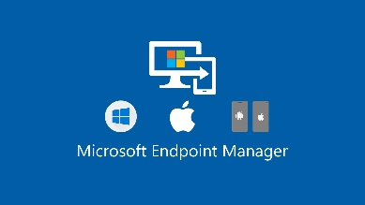











User a.k.a. Identity
In some cases
MAM isn’t possible
MAM
Device Owner?
Type of user?
Personal
Azure AD user
Azure AD guest user
Company
MDM
Azure AD B2B direct Connect settings
App Protection Policy
Approved App
Device Usage?
Compliant?
Company data
Office 365 /SaaS apps
MDCA
Control using Sensitivity labels for containers
Office 365
App Enforced Restrictions

Slide 30
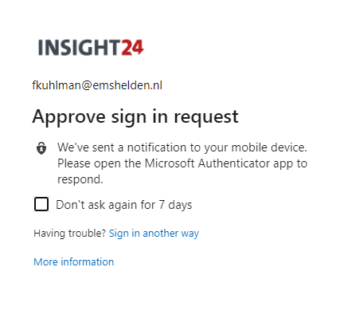
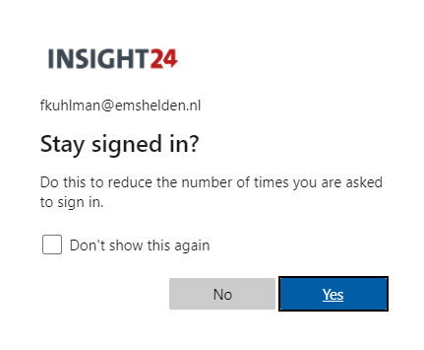
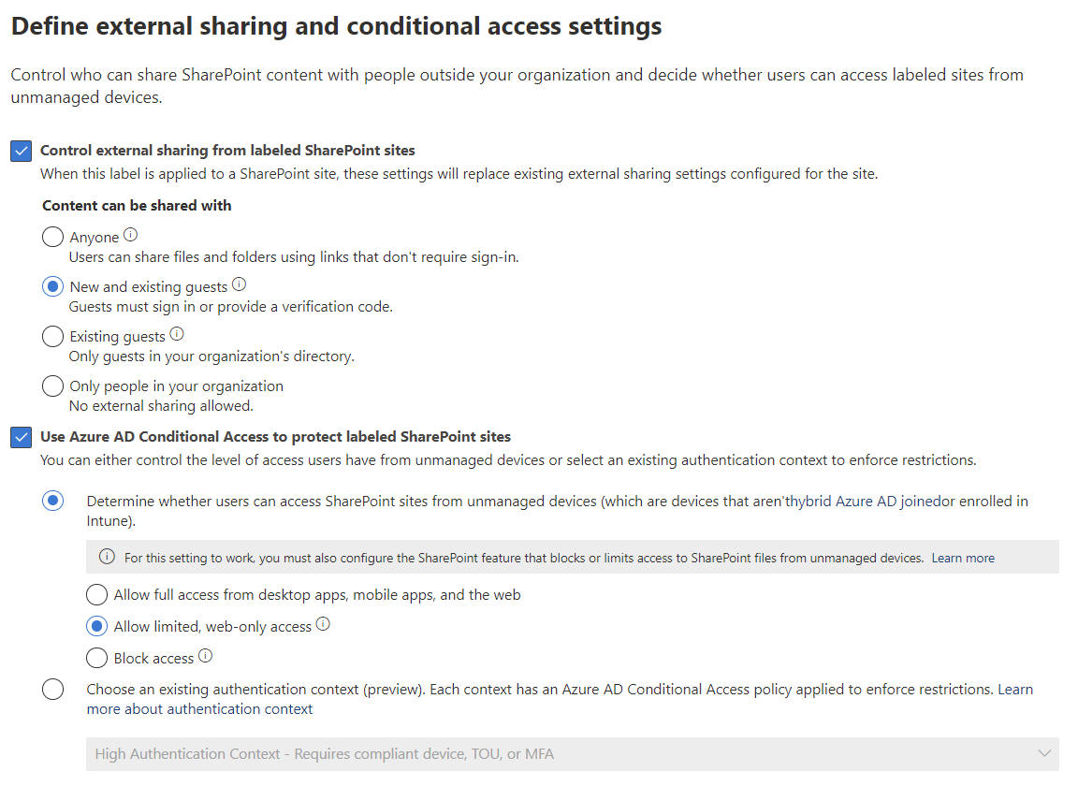
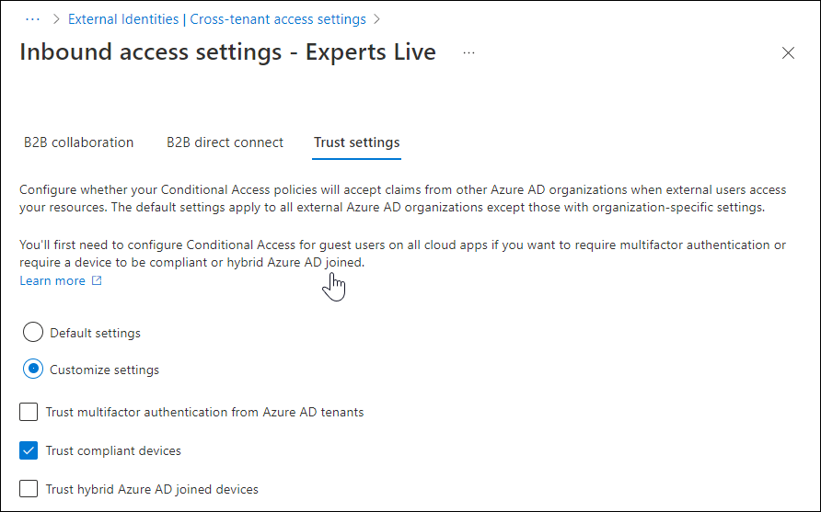
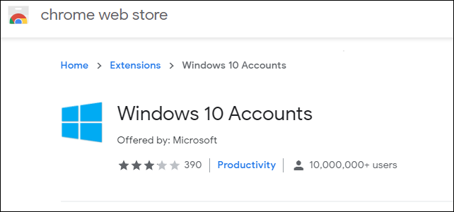
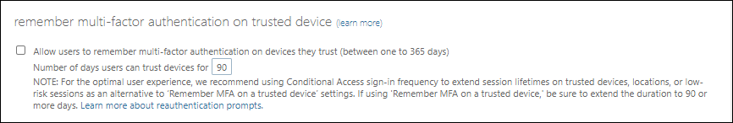

Slide 31
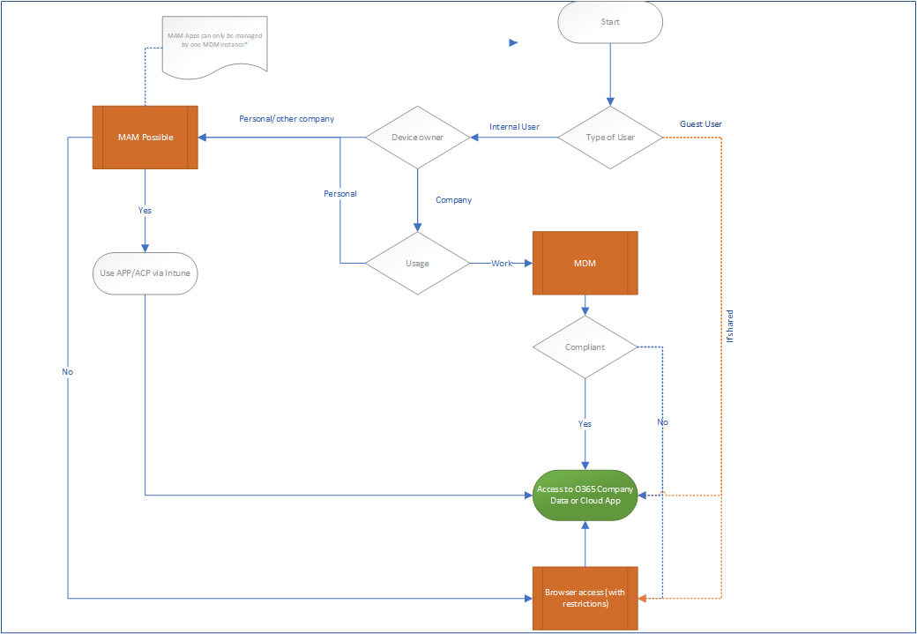

Slide 32


Slide 33
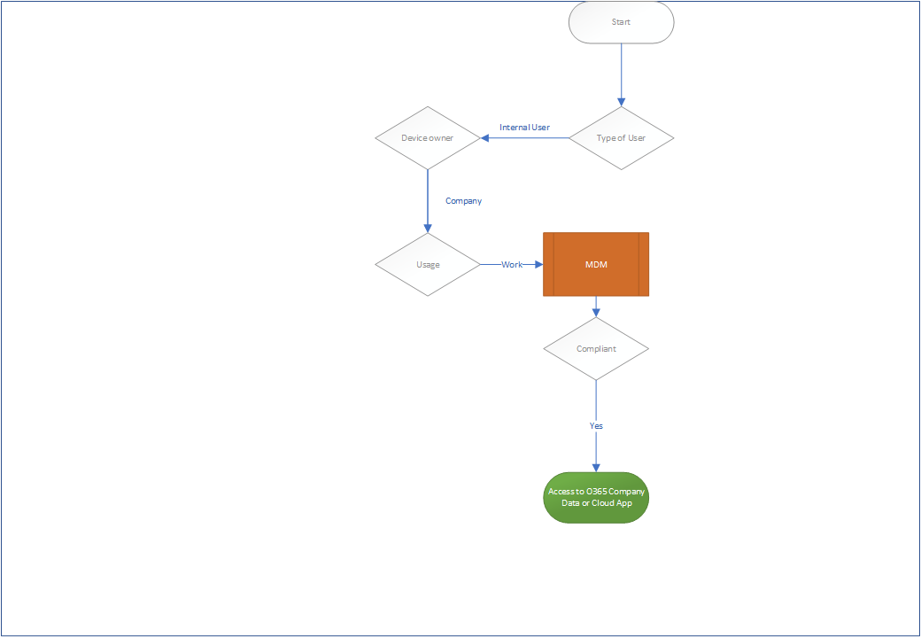

Slide 34
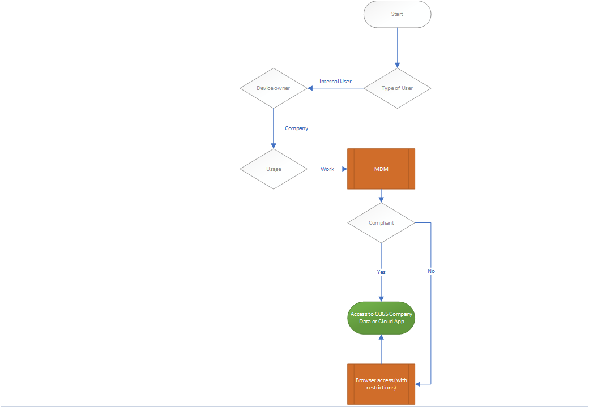

Slide 35
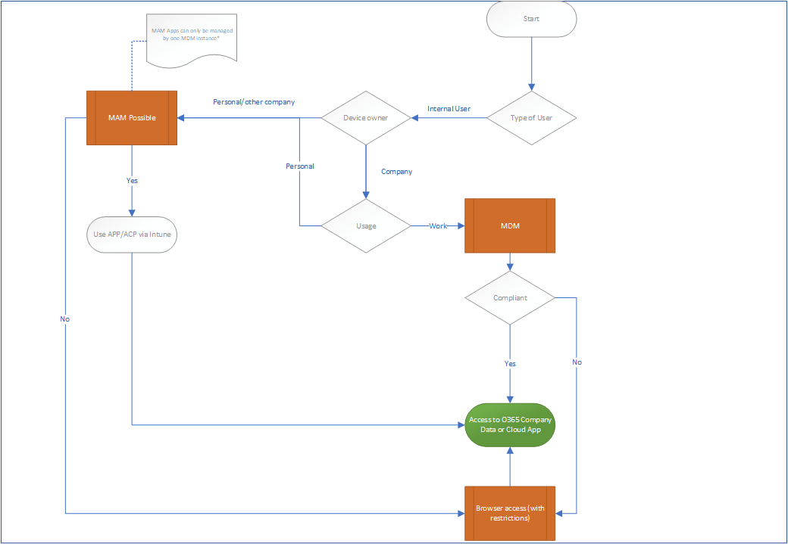

Slide 36
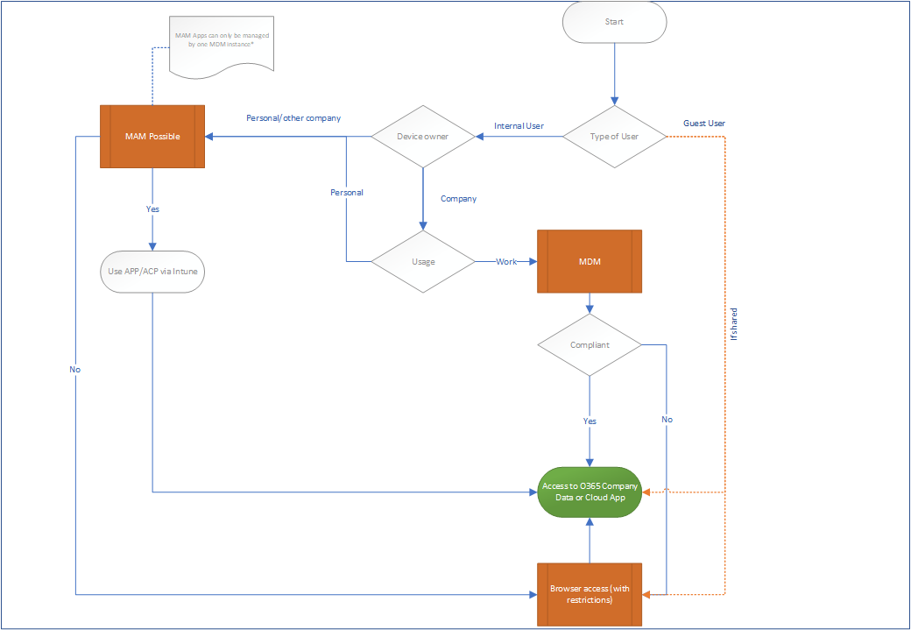

Slide 37
Consequences
Users on mobile devices must be migrated to either MDM or MAM (Outlook and other Office apps on the approved apps list)
We must implement Guest user governance
Ask yourself if you want to allow full access to Guests from unmanaged devices?
We must review the usage of non-personal accounts (Service Accounts)

Slide 38
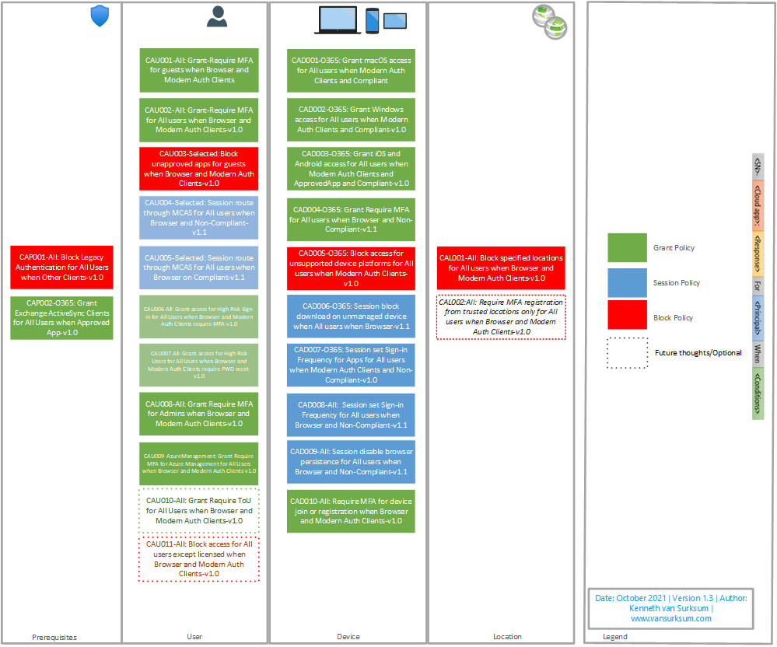

Slide 39
Additional Notes
Even though MS recommends less is better when it comes to CA policies, I prefer granularity
Conditional Access policy per functionality
For each Conditional Access policy there is a specific exclude group (which also includes the Breakglass accounts)
Therefore, if exceptions are made, they can be very specific
Consider implementing access reviews on those exclude groups if you have Azure AD P2
Naming convention is very important, follow MS best practices
The Conditional Access policies are numbered, and versioned
CAP = Conditional Access Prerequisite
CAU = Conditional Access User
CAD = Conditional Access Device
CAL = Conditional Access Location
CAC = Conditional Access Custom
Example: CAD007-O365: Session set Sign-in Frequency for Apps for All users when Modern Auth Clients and Non-Compliant-v1.0

Slide 40
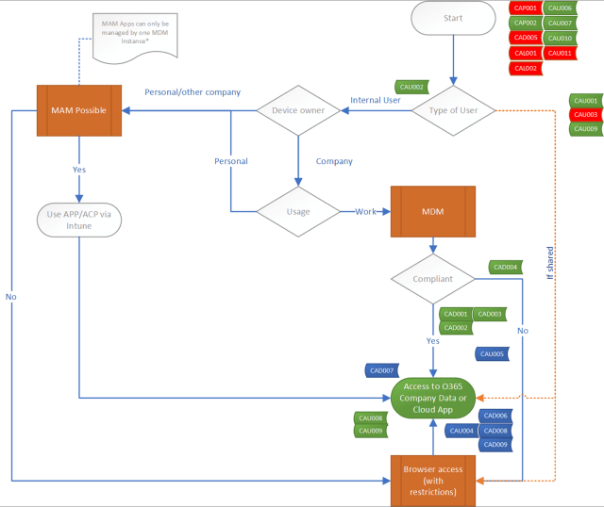

Slide 41
Browser restrictions
OS | Browsers
Windows 10/11 | Microsoft Edge, Internet Explorer, Chrome, Firefox 91+
Windows 8 / 8.1 | Internet Explorer, Chrome
Windows 7 | Internet Explorer, Chrome
iOS | Microsoft Edge, Intune Managed Browser, Safari
Android | Microsoft Edge, Intune Managed Browser, Chrome
Windows Phone | Microsoft Edge, Internet Explorer
Windows Server 2019 | Microsoft Edge, Internet Explorer, Chrome
Windows Server 2016 | Internet Explorer
Windows Server 2012 R2 | Internet Explorer
Windows Server 2008 R2 | Internet Explorer
macOS | Microsoft Edge, Chrome, Safari

Slide 42
Conditional Access
Browser restrictions

Slide 43
Some examples
Prerequisite policies

Slide 44
Some examples

Slide 45
Some examples
Note: Disable the policies in Azure AD Identity Protection

Slide 46
Some examples
Note: Be Very Carefull!

Slide 47
Some examples
Note: Guest access depending on your design choices

Slide 48
Some examples
Notes:
Be careful when setting the SharePoint settings, since that setting will create 2 enabled CA policies without asking
Consider implementing Sensitivity labels if you want more granularity

Slide 49
Some examples
Notes: Review your current reauthentication settings

Slide 50
Conditional Access
Implementation

Slide 51
Authentication Context
Conditional Access Authentication Context can trigger a Conditional Access policy when sensitive content is accessed. With this new functionality new scenarios become available; some examples are:
You can require MFA when a SharePoint site with a certain sensitivity label gets accessed on an unmanaged device.
You can block the session from a Conditional Access policy when a SharePoint site with a certain sensitivity label gets accessed on a unmanaged device.
You can require that Terms of Use must be accepted first before access to a SharePoint site with a certain sensitivity label gets accessed.
You can set the sign-in frequency to a low value when a SharePoint site with a certain sensitivity label gets accessed.
You can trigger the Authentication Context from within a session control policy defined in MCAS, for example to trigger MFA as defined in the Conditional Access policy. You could for example trigger MFA when a document with a certain sensitivity label gets downloaded, or require the user to accept a Terms of Use first.
App developers can leverage the authentication context in their own apps

Slide 52
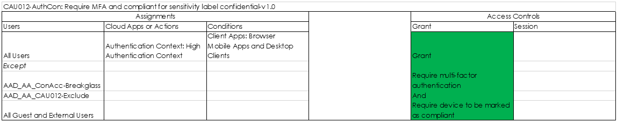
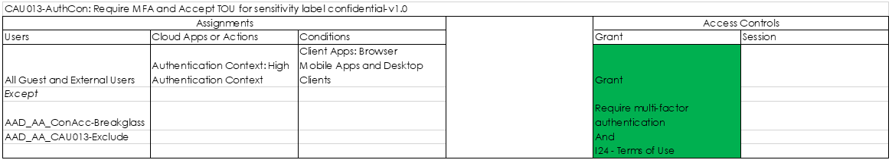
Conditional Access examples

Slide 53
Conditional Access
Authentication Context

Slide 54

Use the Access Review functionality if available (Azure AD P2)
Define operational procedures to execute when something out of your control goes down (f.e. Azure MFA outage)
Regulary review what’s new in Azure AD conditional access and determine if it impacts your environment
You can see what’s new in Azure Active Directory here: https://docs.microsoft.com/en-us/azure/active-directory/fundamentals/whats-new and on the Azure Updates webpage here: https://azure.microsoft.com/en-in/updates/?product=active-directory&status=all&updatetype=features
Some cloud apps have dependencies with other cloud apps, for example Microsoft Teams has dependencies of Exchange Online, SharePoint and Planner and perhaps even more.
What are service dependencies in Azure Active Directory Conditional Access? – https://docs.microsoft.com/en-us/azure/active-directory/conditional-access/service-dependencies
Make sure that you can test your scenarios (have equipment available)
Android device, Apple Device, Windows 10 device, VPN software….
Create Alerts in Log Analytics to notify you when:
New Conditional Access policies are created
Existing Conditional Access policies are modified

Slide 55
Conditional Access
Troubleshooting Conditional Access policies

Slide 56
Further Resources
Azure Active Directory @ MSDN – https://social.msdn.microsoft.com/Forums/en-US/home?forum=WindowsAzureAD
Azure Active Directory @ Stack Overflow – https://stackoverflow.com/questions/tagged/azure-active-directory
UserVoice:
https://feedback.azure.com/forums/169401-azure-active-directory/category/167259-conditional-access

Slide 57
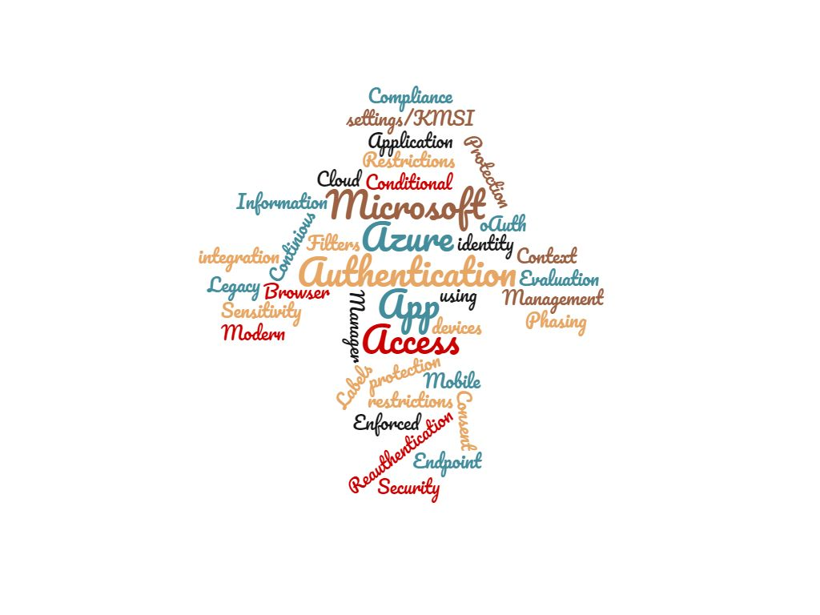
So much more to tell

Slide 58

Please rate my session in Yellenge

Slide 59
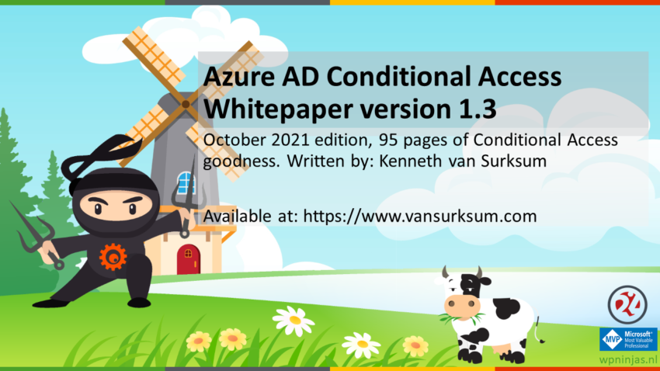
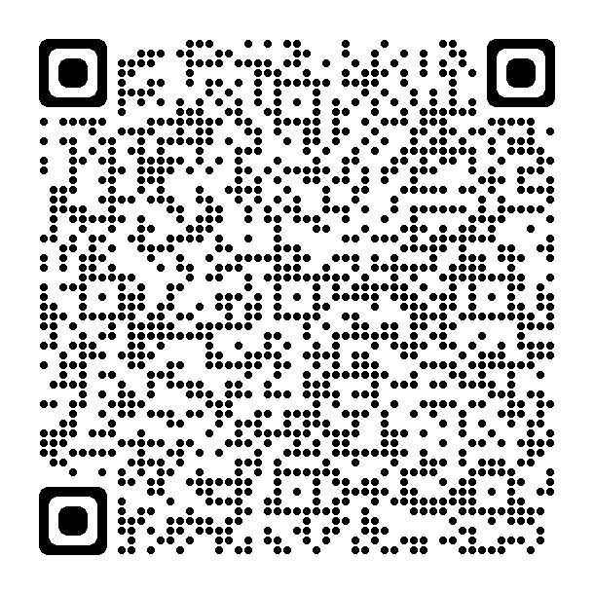
White paper
Latest release: The October 2021 update of the Conditional Access demystified whitepaper.
Major release (from 77 to 95 pages)
Includes updates workflow cheat sheet
Much more information added
Download the paper from my blog at:
https://www.vansurksum.com/2021/10/14/october-2021-update-of-the-conditional-access-demystified-whitepaper-and-workflow-cheat-sheet/

Slide 60
References
Microsoft is going to disable basic/legacy authentication for Exchange Online. What does that actually mean and does that impact me?
Understanding and governing reauthentication settings in Azure Active Directory
Extending Conditional Access to Microsoft Cloud App Security using Conditional Access App Control
Azure AD Identity Protection deep dive
Azure AD Continuous access evaluation (CAE), a first look
Limit Access to Outlook Web Access, SharePoint Online and OneDrive using Conditional Access App Enforced Restrictions
Defining more granularity for your Conditional Access App Enforced Restrictions using Sensitivity Labels
Mobile Application Management for Mobile Devices with Microsoft Endpoint Manager/Intune deep dive
Conditional Access demystified: My recommended default set of policies
Defining more granularity for your Conditional Access App Enforced Restrictions using Sensitivity Labels
Designing and building your Microsoft Endpoint Manager/Intune environment for Operations

